Slide 1
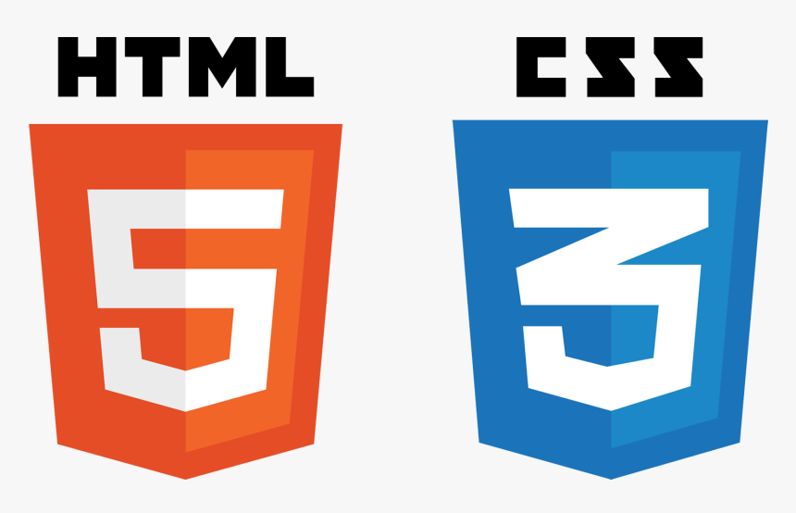

SE321
Lecture 5: Responsive Web Design
SK. Fazlee Rabby
Lecturer
Department of Software Engineering
Daffodil International University

Slide 2
RECAP
We’ve Talked About:
- CSS and some basic properties
- Techniques of adding CSS to our HTML pages
- Class and Ids
- Different types of Selectors
- Pseudo Class
- CSS Box Model
- Element Rendering Mode: Float

Slide 3
TODAY’S TOPIC
We Will Discuss:
- Advance Rendering Mode: Flexbox
-

Slide 4
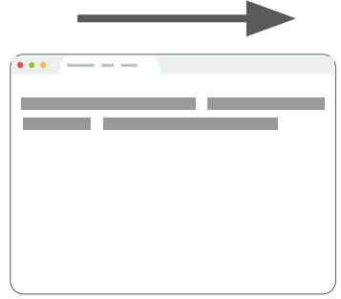
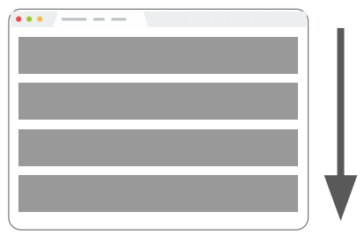
CSS LAYOUT SO FAR
Block layout Laying out large sections of a page
Inline layout Laying out text and other inline content within a section

Slide 5
CSS LAYOUT RENDERING MODE WE LEARNT SO FAR: FLOAT
The early web was influenced by print/academic publications where floats are used to control the flow of figures and tables in text.
Floats were never meant for Layouts: They’re simply meant to take an element, put it to one side, and let other content flow around it. That’s all.

Slide 6
So Why Did We Use Them For Layout?
Because we can clear a block below two floated columns, float layout came into being. If there had ever been a way to “clear” elements below positioned elements, we’d never have bothered to use floats for layout.
Summary: Floats should not be used for layout anymore as there are other more sophisticated way to create complex layouts that also supports different size devices.

Slide 7
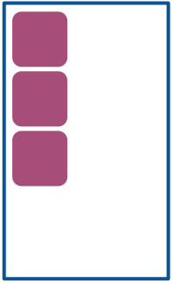
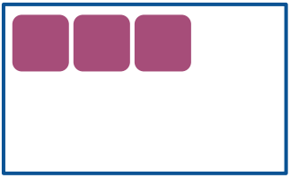
FLEX LAYOUT
To achieve more complicated layouts, we can enable a different kind of CSS layout rendering mode: Flex layout.
Flex layout defines a special set of rules for laying out items in rows or columns.

Slide 8
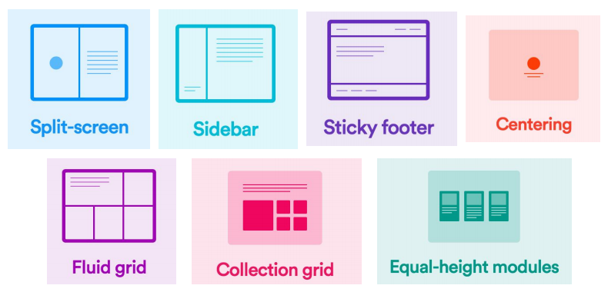
FLEX LAYOUT
Flex layout solves all sorts of problems. Here are some examples of layouts that are easy to create with flex layout (and really difficult otherwise):

Slide 9
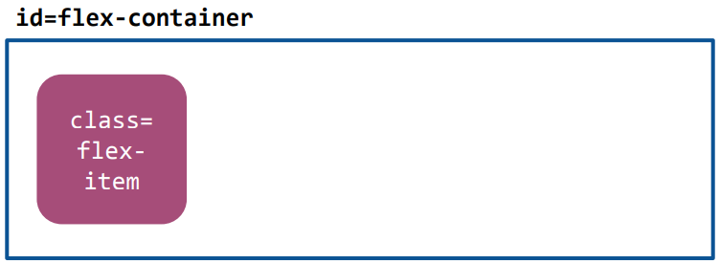
FLEX BASICS
Flex layouts are composed of:
- A Flex container, which contains one or more:
- Flex item(s)

Slide 10
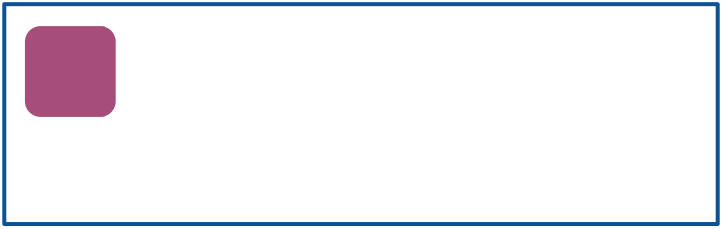
FLEX BASICS
To make an element a flex container, change display
- Block container - display: flex; or
- Inline container - display: inline-flex;
Follow along in Codepen

Slide 11
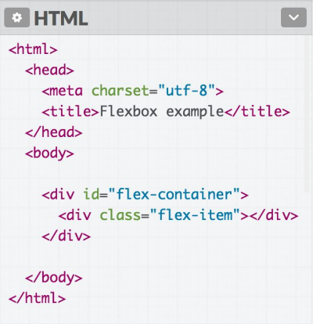
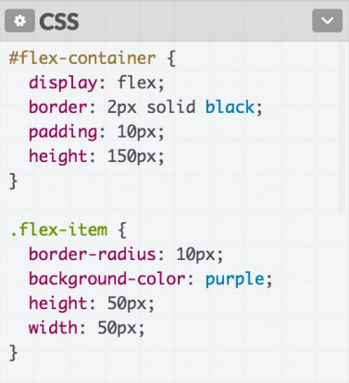
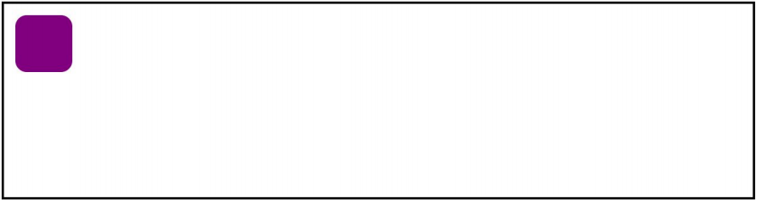
So Far, This looks exactly the same as, display:block

Slide 12
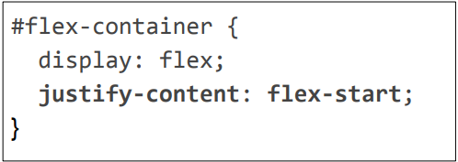
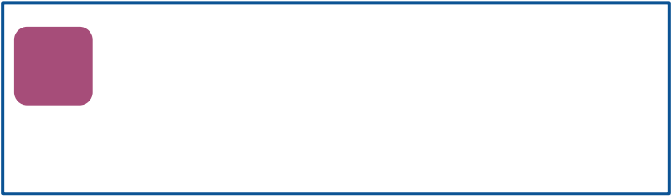
FLEX BASICS: justify-content
You can control where the item is horizontally* in the box by setting justify-content on the flex container:
*when flex direction is row. We'll get to what "flex direction" means soon.

Slide 13
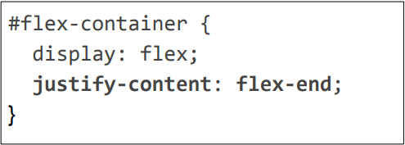
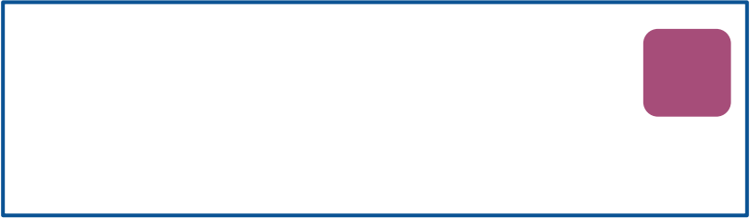
FLEX BASICS: justify-content
You can control where the item is horizontally* in the box by setting justify-content on the flex container:
*when flex direction is row. We'll get to what "flex direction" means soon.

Slide 14
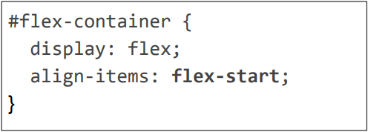
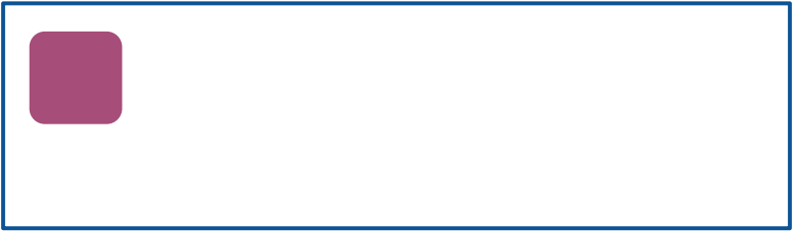
FLEX BASICS: align-items
You can control where the item is vertically* in the box by setting align-items on the flex container:
*when flex direction is row. We'll get to what "flex direction" means soon.

Slide 15
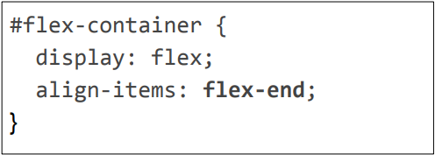
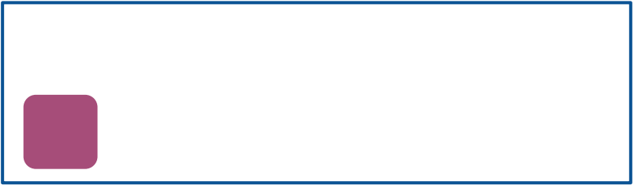
FLEX BASICS: align-items
You can control where the item is vertically* in the box by setting align-items on the flex container:
*when flex direction is row. We'll get to what "flex direction" means soon.

Slide 16
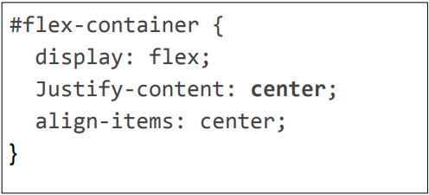

FLEX BASICS: align-items (Multiple Items)

Slide 17
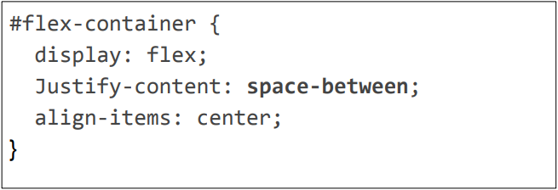
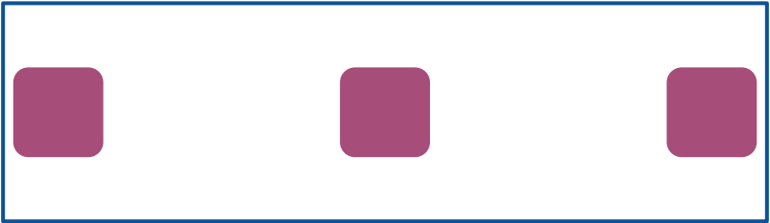
FLEX BASICS: align-items (Multiple Items)
And there is also space-between and space-around

Slide 18
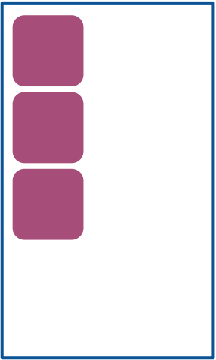
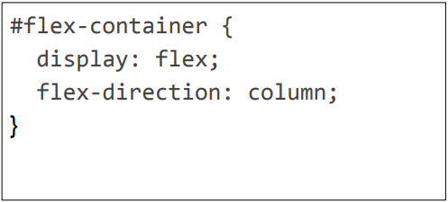
flex-direction
We can also layout columns instead of rows.

Slide 19
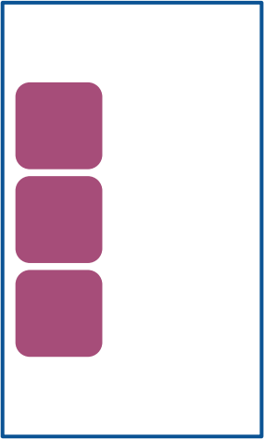
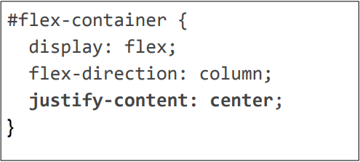
flex-direction
We can also layout columns instead of rows.
Now justify-content controls where the column is vertically in the box

Slide 20
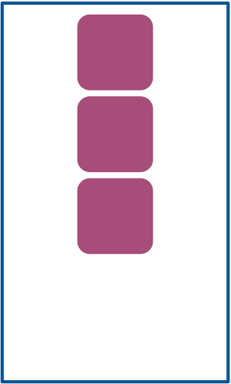
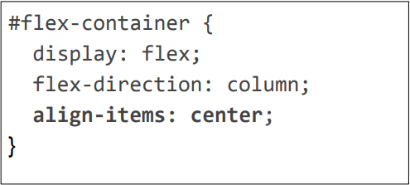
flex-direction
We can also layout columns instead of rows.
Now align-items controls where the column is horizontally in the box

Slide 21
flex-direction
We can also layout columns instead of rows.
Now align-items controls where the column is horizontally in the box

Slide 22
Flex Item Sizing: flex-basis
Flex items have an initial width*, which, by default is either:
- The content width, or
- The explicitly set width property of the element, or
- The explicitly set flex-basis property of the element
This initial width* of the flex item is called the flex basis.
*width in the case of rows; height in the case of columns

Slide 23
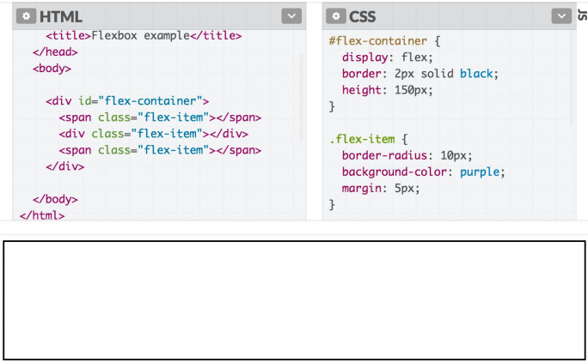
Flex Item Sizing: flex-basis
If we unset the height and width, our flex items disappears, because the flex basis is now the content size, which is empty.

Slide 24
Flex Item Sizing: flex-shrink
The width* of the flex item can automatically shrink smaller than the flex basis via the flex-shrink property.
flex-shrink
- If set to 1, the flex item shrinks itself as small as it can in
the space available.
- If set to 0, the flex item does not shrink.
Flex items have flex-shrink: 0 by default

Slide 25
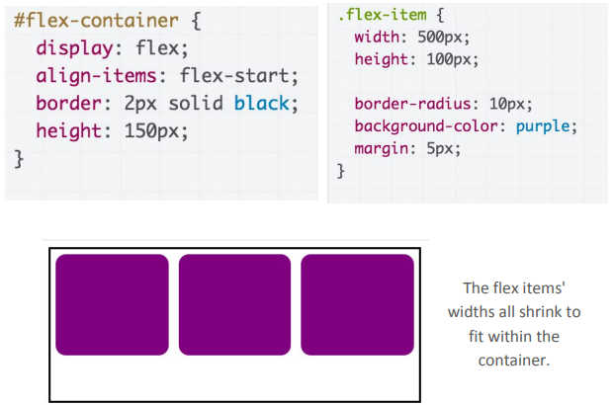
Flex Item Sizing: flex-shrink

Slide 26
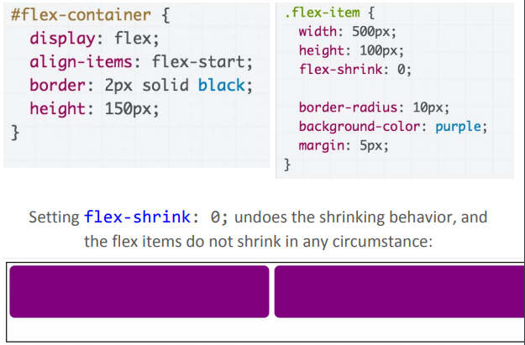
Flex Item Sizing: flex-shrink

Slide 27
Flex Item Sizing: flex-grow
The width* of the flex item can automatically grow larger than the flex basis via the flex-grow property:
flex-grow:
- If set to 1, the flex item grows itself as large as it can in the
space remaining.
- If set to 0, the flex-item does not grow.
Flex items have flex-grow: 0 by default.

Slide 28
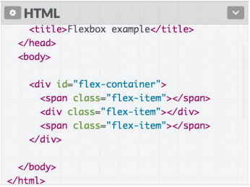
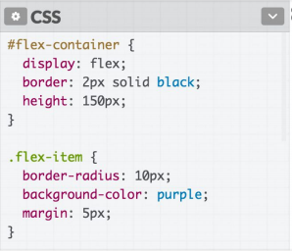
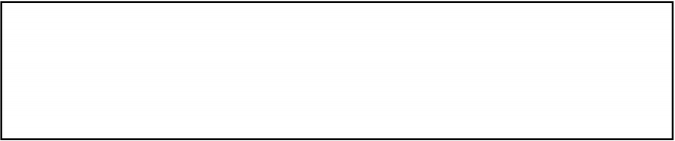
flex-grow Example

Slide 29
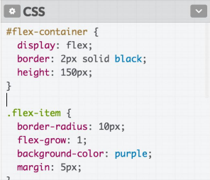
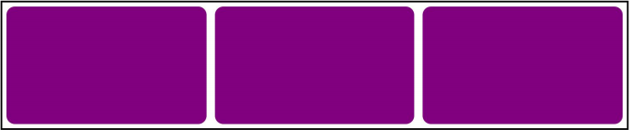
Flex Item Height?
Note that flex-grow only controls width*.
So why does the height** of the flex items seem to "grow" as well?
*width in the case of rows; height in the case of columns
**height in the case of rows; width in the case of columns

Slide 30
align-items: stretch
The default value of align-items is stretch, which means every flex item grows vertically* to fill the container by default.
(This will not happen if the height on the flex item is set)
If we set another value for align-items, the flex items disappear again because the height is now content height, which is 0.
*width in the case of rows; height in the case of columns
**height in the case of rows; width in the case of columns

Slide 31
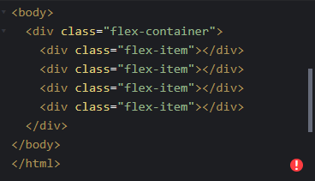
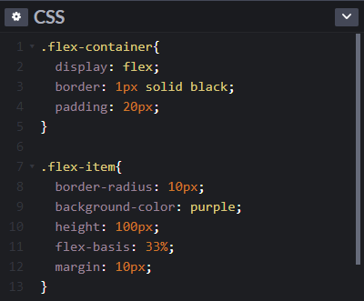
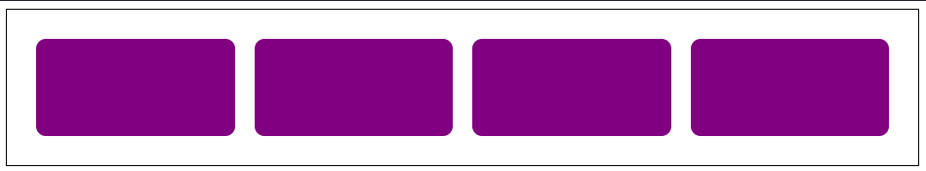
flex-wrap
What if we want that the flex-items should not shrink to accommodate on the same row, rather move on the next row?

Slide 32
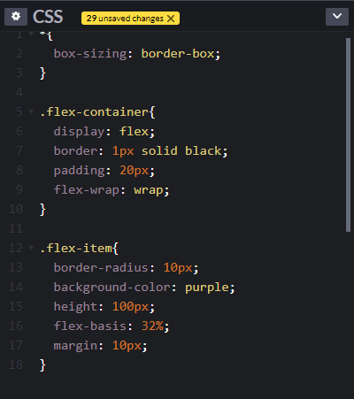
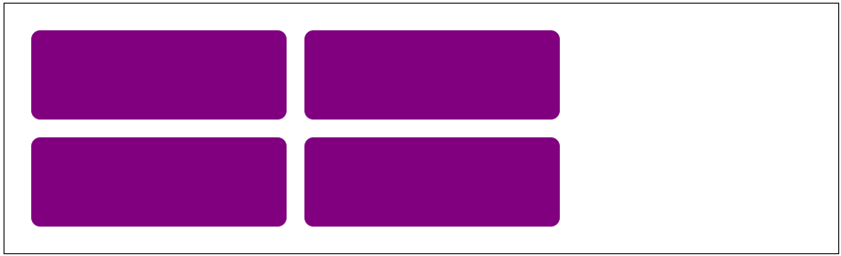
flex-wrap
What if we want that the flex-items should not shrink to accommodate on the same row, rather move on the next row?

Slide 33
Another Rendering Mode: position

Slide 34
Moving things with position
Positioned layout lets you define precisely where an element should be in the page (mdn).
You can use positioned layout doing the following:
Define a position method: static, fixed, absolute, relative
Define offsets: top, left, bottom, and right
(optional) Define z-index for overlapping layers (mdn)

Slide 35
Moving things with position
To specify exactly where an element goes, set its top, left, bottom, and/or right offset.
The meaning of these offset values depend on the reference point set by position
static: no reference point; static block can't move (This is the default style for every element)
fixed: a fixed position within the viewport
absolute: a fixed position within its "containing element"
relative: offset from its normal static position

Slide 36
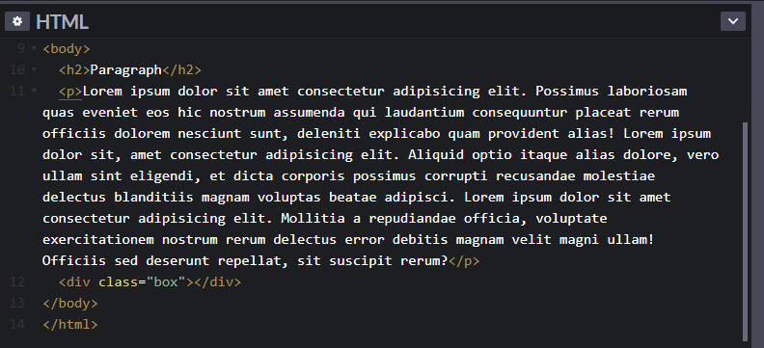
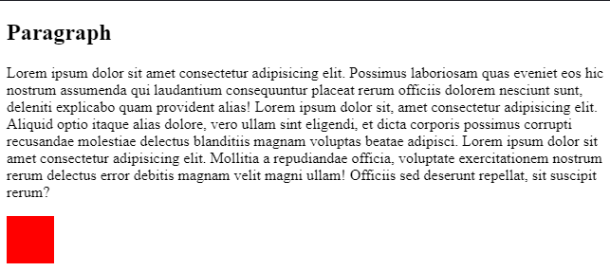
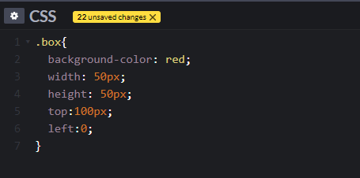
position: static (Nothing Happens)
static is the default value for position
If you use top / left / bottom / right without setting a non-static position, nothing will happen

Slide 37
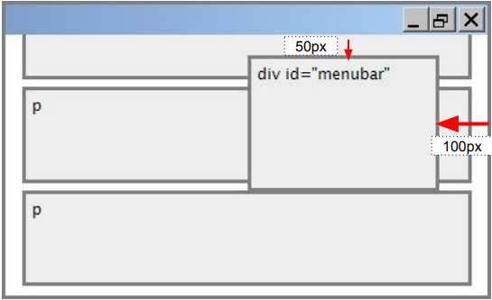
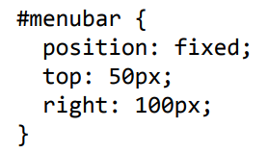
position: fixed
For fixed positioning, the offset is the distance positioned relative to the viewport.
The element does not move when scrolled.
Element is removed from normal document flow, positioned on its own layer

Slide 38
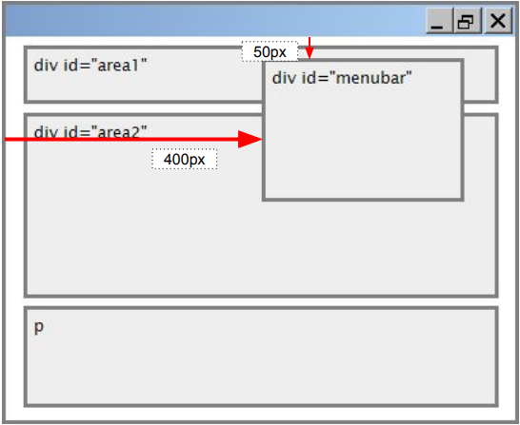
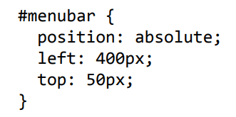
position: absolute
For absolute positioning, the offset is the distance from the "containing element", which is the viewport by default
Element is removed from normal document flow, positioned on its own layer

Slide 39
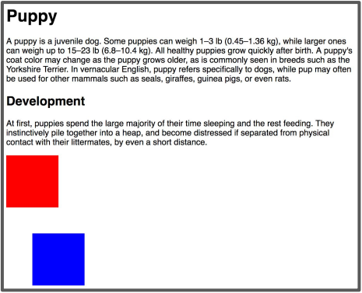
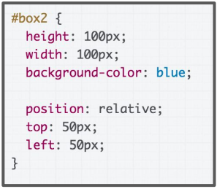
position: relative
For position: relative; the element is placed where it would normally be placed in the layout of the page, but shifted by the top / left / bottom / right values.

Slide 40
Relative Absolute Positioning
Let's revisit the definition of absolute positioning:
absolute: a fixed position within its "containing element“
The containing element is the viewport by default
You can change the containing element by setting "position: relative;" on some parent of your absolutely positioned element!

Slide 41


Relative Absolute Positioning
Offsets are relative to the first parent element that has position: relative which in this case is #area2

Slide 42


Common Use Case: Overlay
Image URL

Slide 43
Random Useful CSS

Slide 44
calc
You can use the calc CSS function to define numeric values in terms of expressions:
width: calc(50% - 10px);
width: calc(100% / 6);
(MDN details of calc)

Slide 45
CSS Variables
Variables are a new CSS feature (caniuse).
:root {
--primary-color: hotpink;
}
h1 {
background-color: var(--primary-color);
}
(MDN details of CSS Variables)

Slide 46
background properties
An easy way to render images stretched and cropped to a given size: set it as a background image for an element.
background-image: url(background.png);
You can then use additional background properties to further style it:
background-size: cover;
background-size: contain;
background-repeat: no-repeat;
background-position: top;
background-position: center;

Slide 47

Web Fonts
We can use Google Fonts to choose from better fonts
The instructions are pretty self-explanatory:
Basically, add the given <link> tag into the <head> section of your page alongside your other CSS files.

Slide 48

Fallback Fonts
Notice that the Google Font example shows a comma-separated list of values for font-family:
Each successive font listed is a fallback, i.e. the font that will be loaded if the previous font could not be loaded
There are also generic font names, which allows the browser to choose the font based on intent + fonts available on the OS.
It's good practice to list a generic font at the end of all your font-family declarations.

Slide 49

Hosted Fonts with @font-face
You can also load your own font via @font-face:
Give it your own font name
Link to where the font file is found
Font Link

Slide 50
Mobile Web

Slide 51

Say we have the following website
Q: What does it look like on a phone?

Slide 52


Not Terrible, But Pretty Hard to Read

Slide 53
Responsive Web Design
We want to write our CSS in a way that can look nice in a wide range of screen sizes:
27" desktop monitor
Macbook Air
Samsung Galaxy S7
iPhone 7
iPad
Q: How do we do this?
Do we need to write totally different
CSS for every screen size?!

Slide 54
Mobile Sizing
Unless directed otherwise via HTML or CSS cues, mobile browsers render web pages at a desktop screen width (~1000px), then "zooms out" until the entire page fits on screen.
(That's why we sometimes get web pages with teeny-tiny font on your phone: these webpages have not added support for mobile.)

Slide 55
Meta Viewport Tag
To prevent phone browsers from rendering the page at desktop width and zooming out, use the meta viewport tag:
<meta name="viewport"
content="width=device-width, initial-scale=1">
This belongs in <head> the section of your HTML. (Same section as the <title>, <link> , and other metadata elements.)

Slide 56
Meta Viewport Tag
<meta name="viewport"
content="width=device-width, initial-scale=1">
name=viewport: "Browser, I am going to tell you how I want the viewport to look.“
width=device-width: "The viewport's width should always start at the device's width." (i.e., don't do that thing on mobile where you render the page at the desktop's width)
initial-scale=1: "Start at zoom level of 100%."
(We should pretty much always include this tag in our HTML.)

Slide 57

CSS media queries
You can define a CSS media query in order to change style rules based on the characteristics of the device:

Slide 58
Mobile Summary
Always add the meta viewport tag
Use @media queries to add styles for devices with certain characteristics, such as screen width
Use the Chrome Device Mode to simulate mobile rendering on desktop
For height and width, prefer percentages

